Slide 1

Women for Women Workshops
Algorithmic Thinking
. . . . . . . . . . . . . . . . . . . . . . . . . . . . . . . . . . . . . . . . . . . . . . . .
Slack: wfwworkshop.slack.com
Facebook: facebook.com/WfWworkshopFinland
Meetup: meetup.com/Women-for-Women-Workshops
. . . . . . . . . . . . . . . . . . . . . . . . . . . . . . . . . . . . . . . . . . . . . . . .
Notes:
Welcome, photos

Slide 2
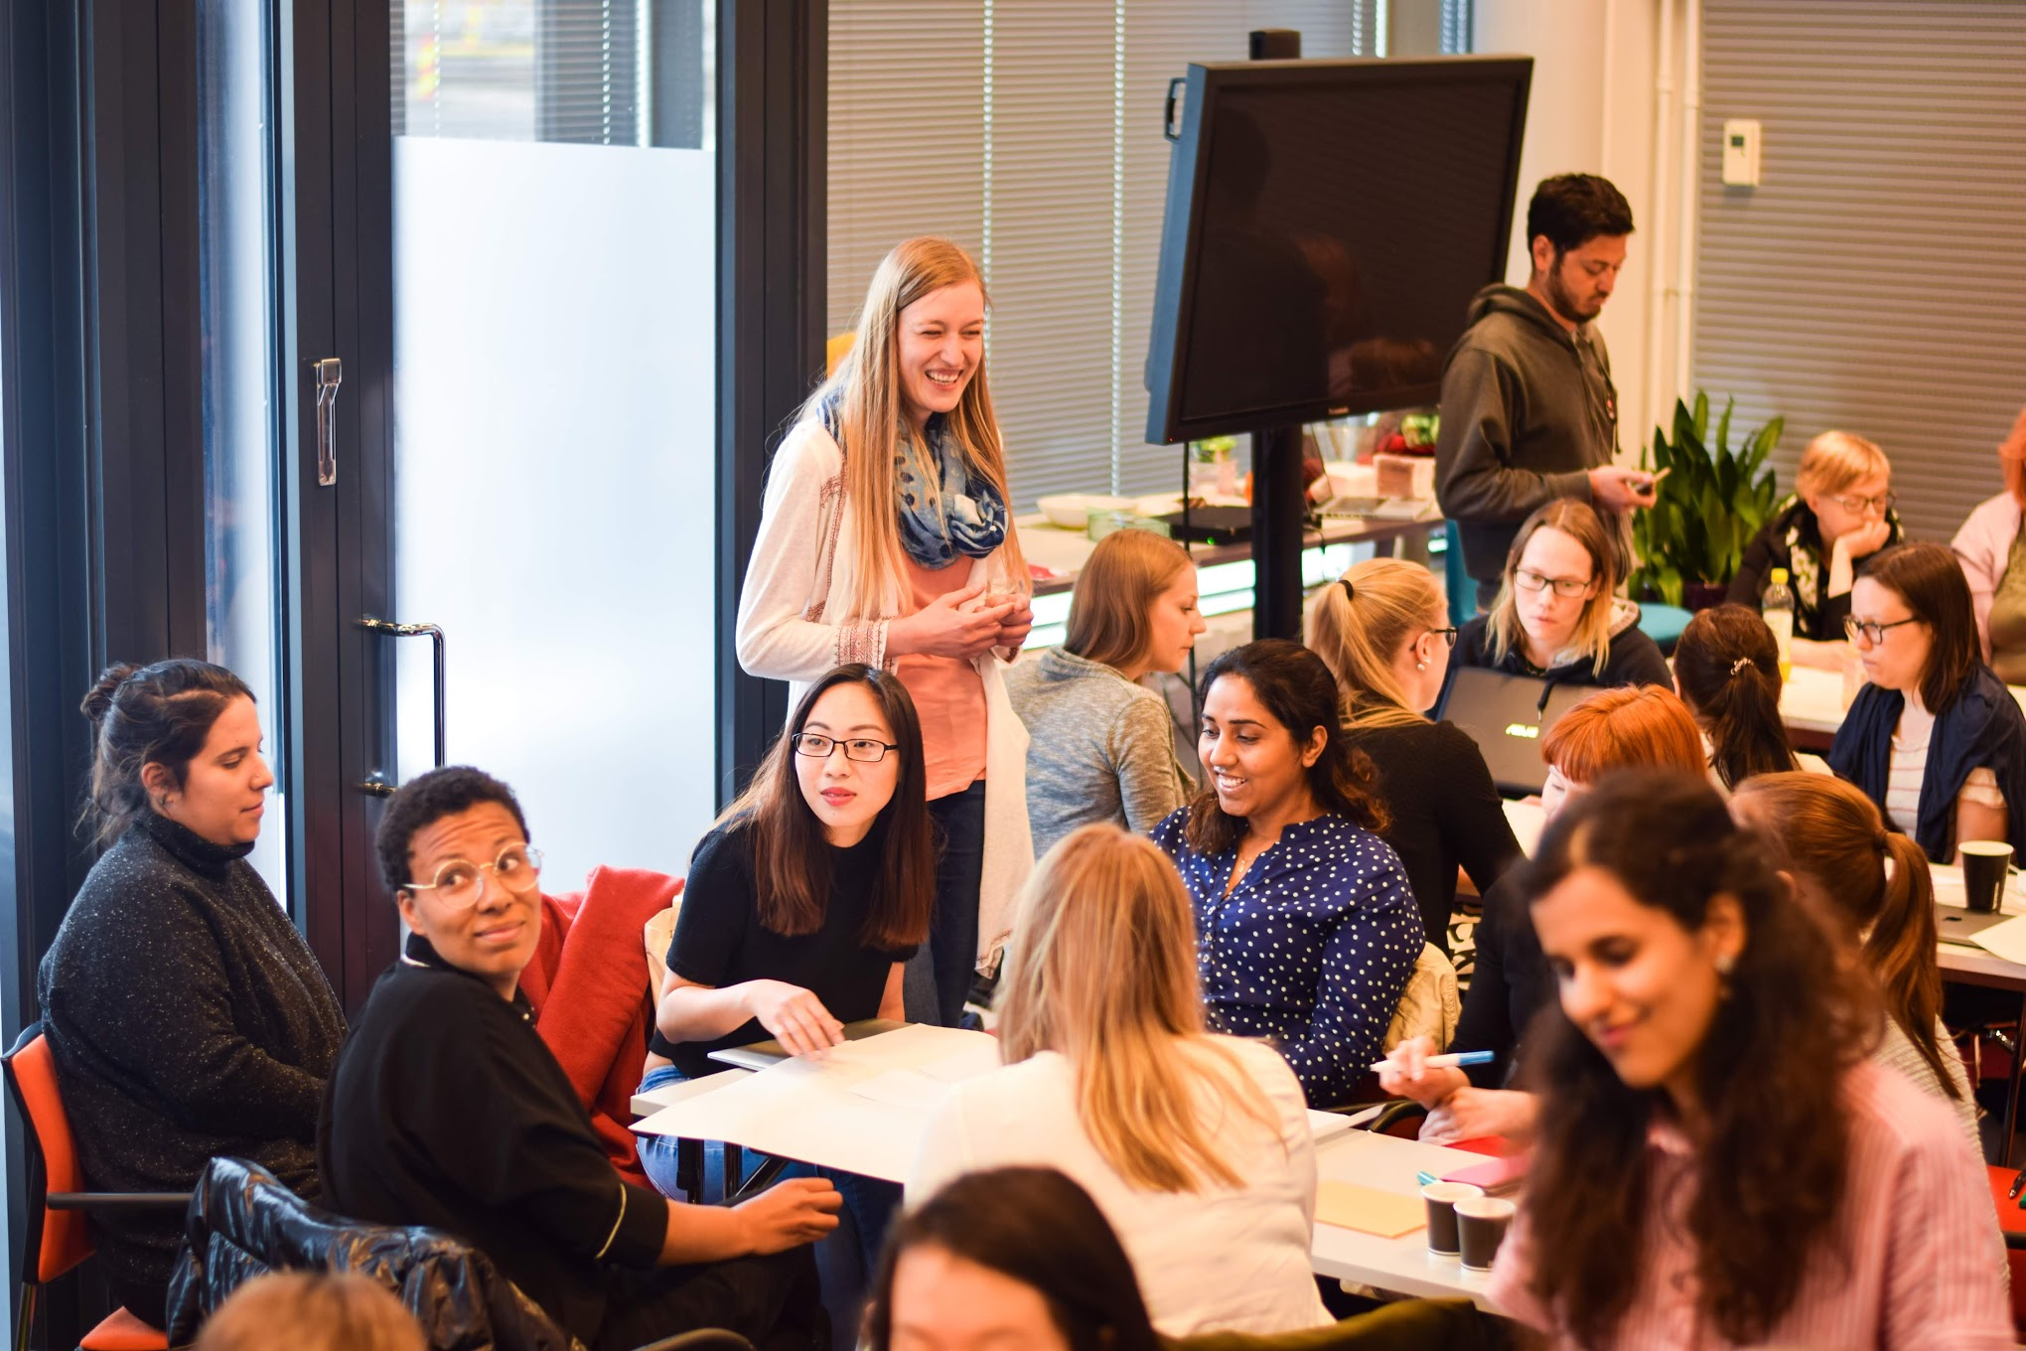
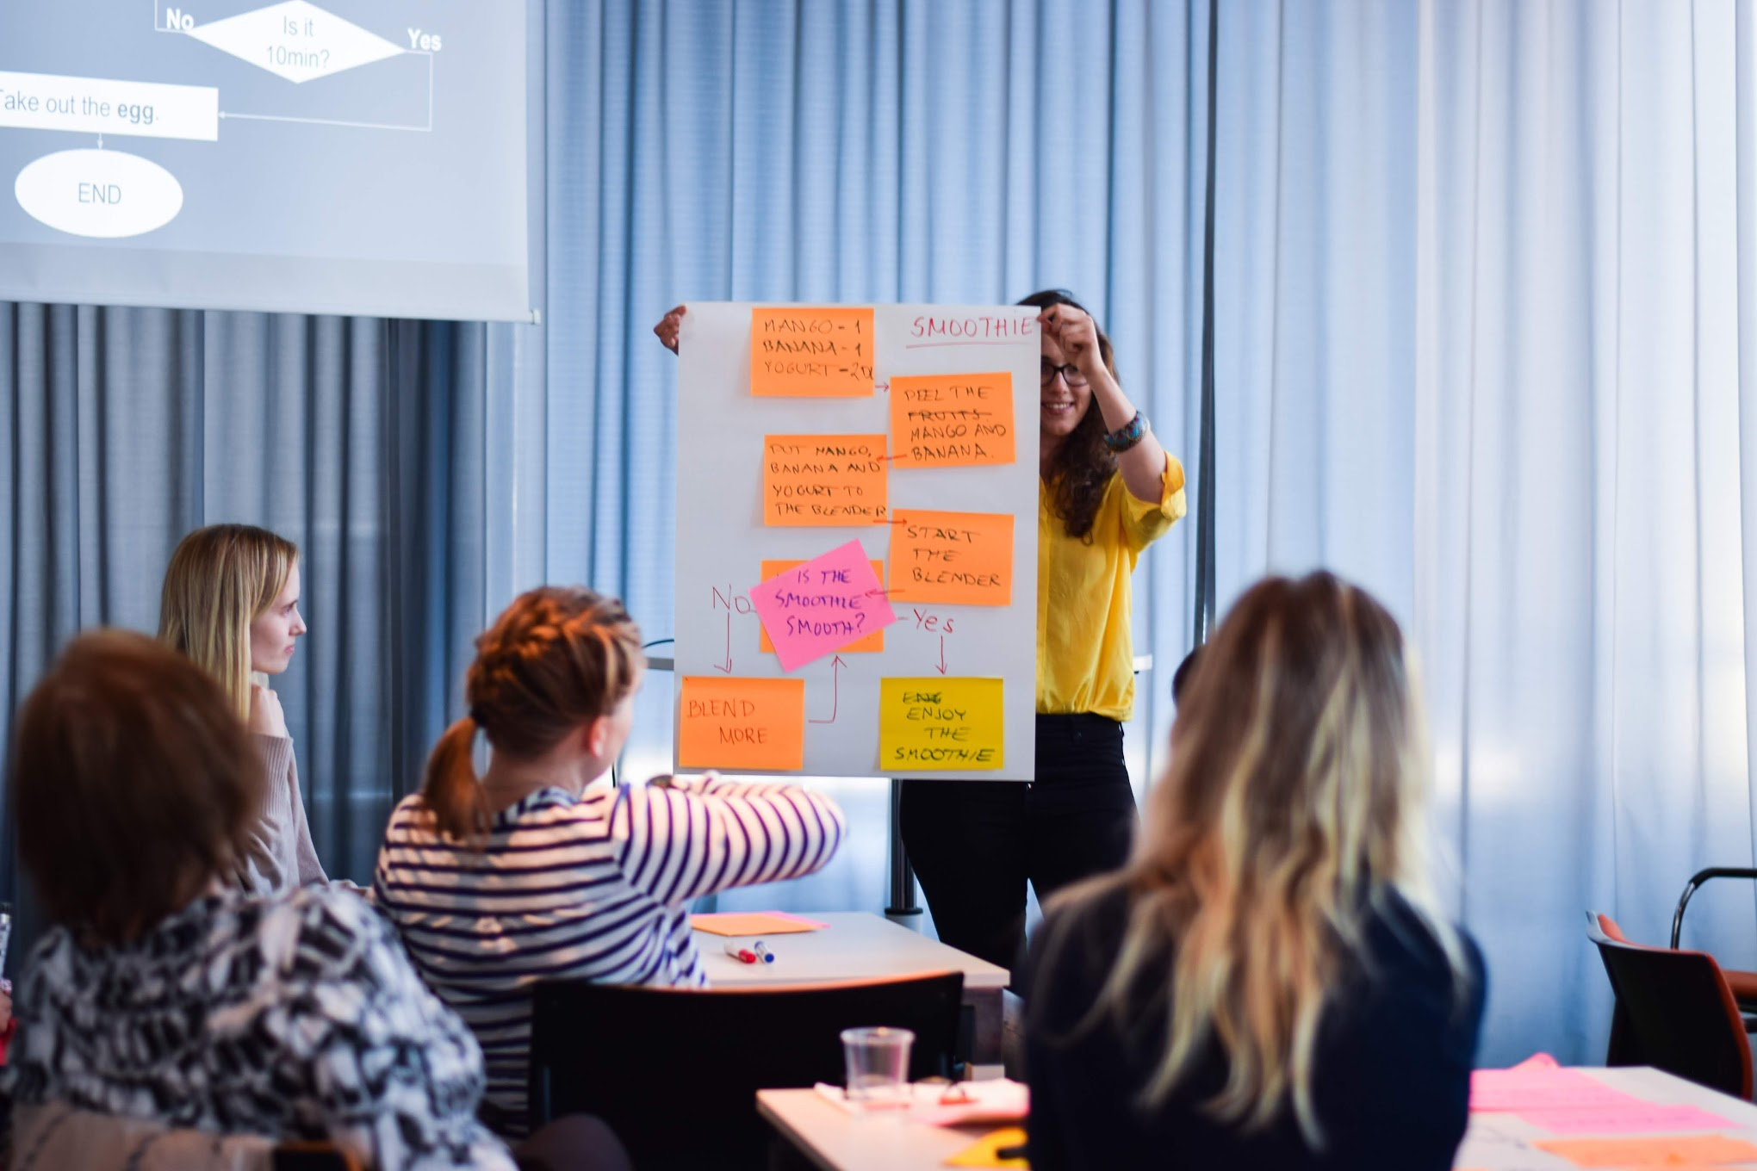
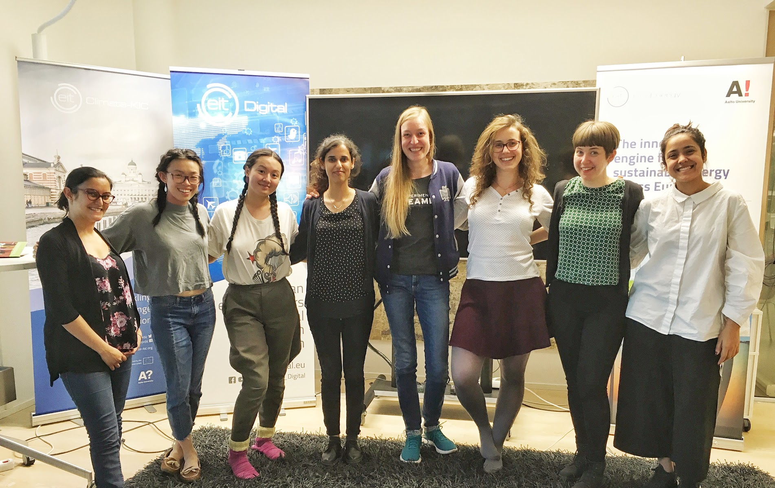

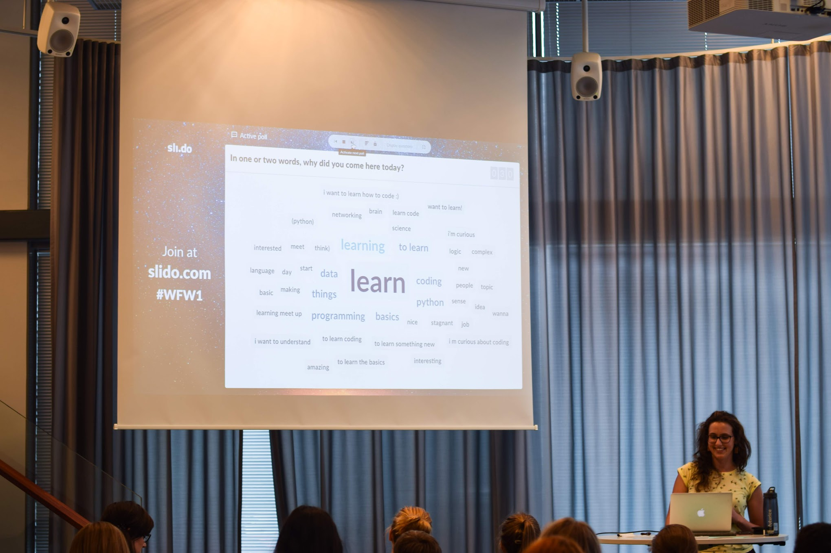
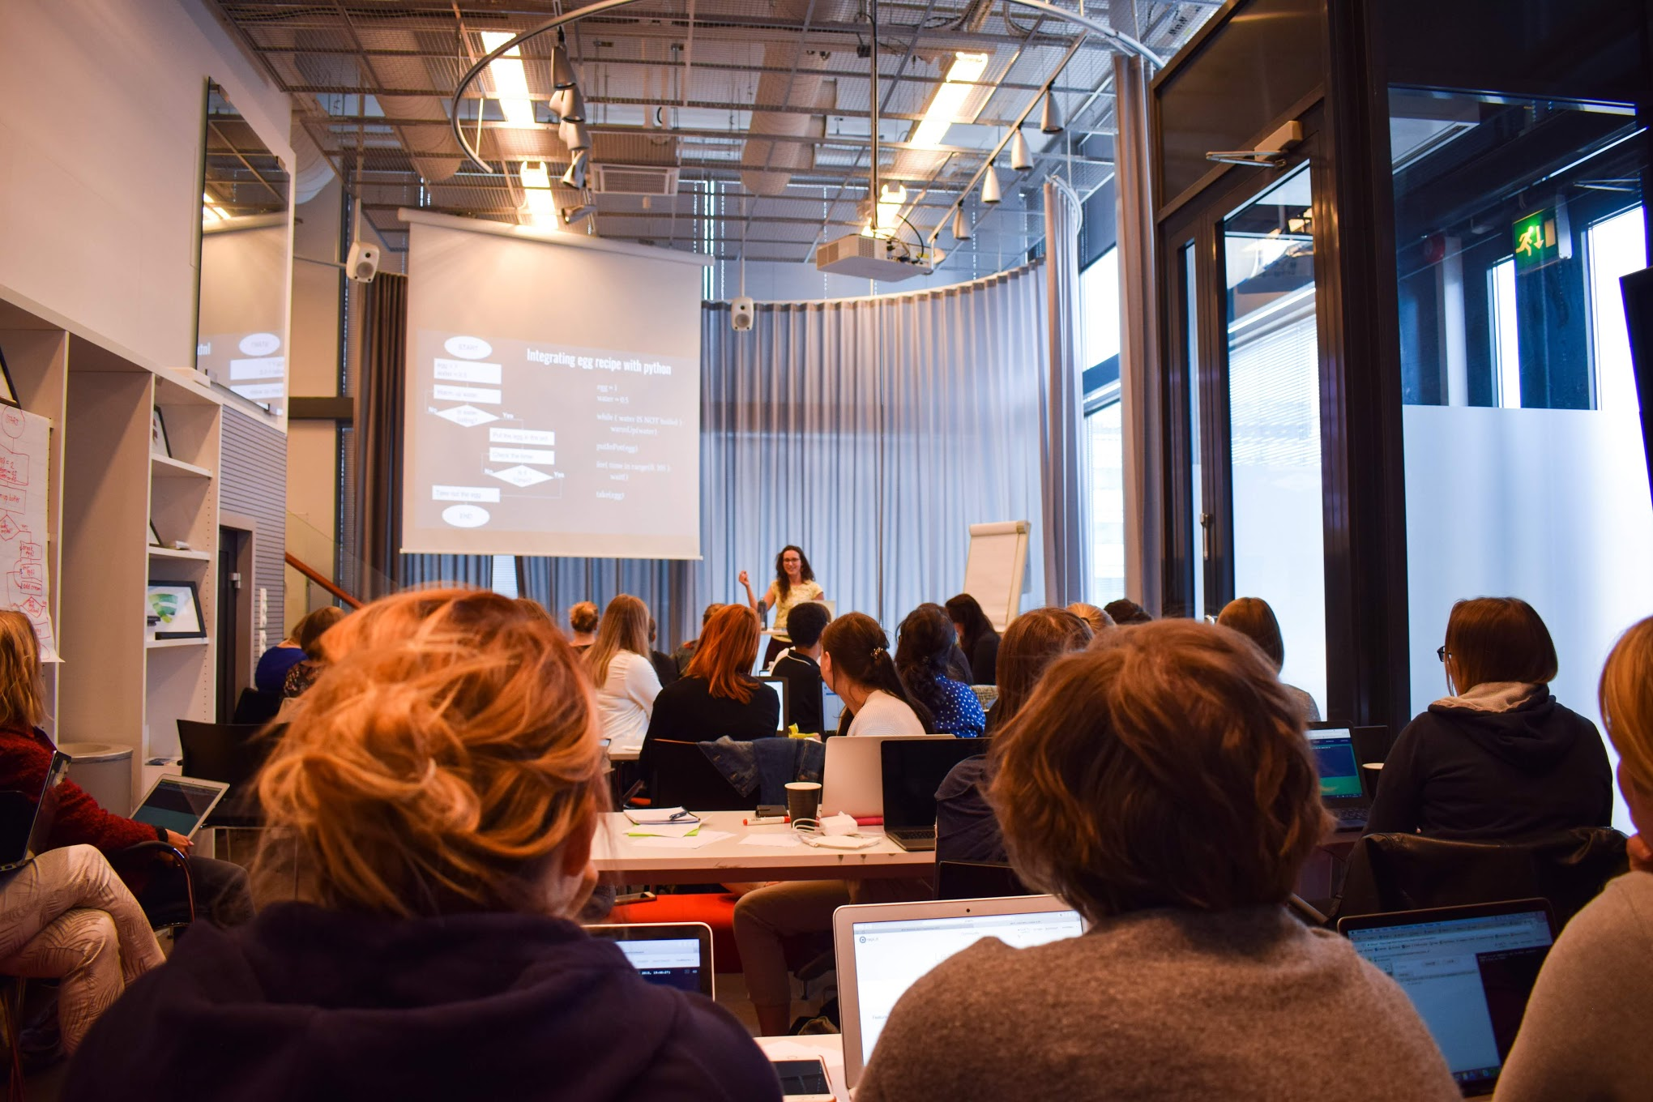
Women for Women workshops

Slide 3



Other helpful organisations :)
facebook.com/womenatEIT
https://women.eitalumni.eu/
https://www.eitdigital.eu /about-us/locations/helsinki-clc/
facebook.com/womenofaalto
Instagram: @womenofaalto

Slide 4

Notes:
While waiting for them to open slido: “we want to make is as interactive as possible, so please feel invited to ask questions. If you don’t want to interrupt/ask aloud - here is a slido tool for asking questions”

Slide 5
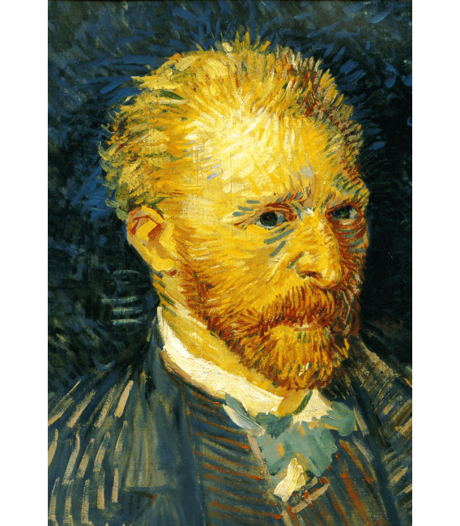

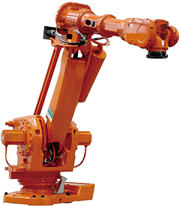
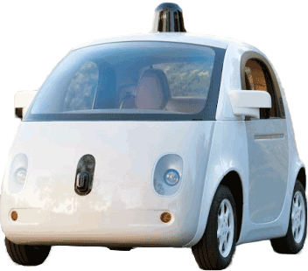

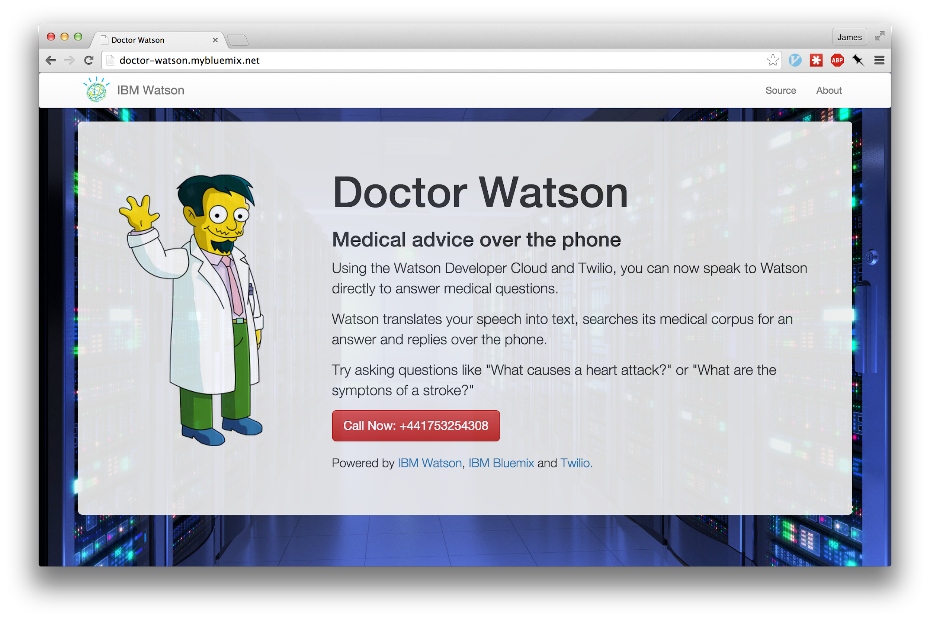


Programming is a tool for…
Notes:
You can think of programming as a tool to do some actions. Do you have any ideas what can we program? Programming robots (industry, washing machine, cars)
Creating applications (mobile phone, facebook)
Creating Art (fractals, VanGogh)
Help doctors (ibm watson)
3-D animations (disney, game)

Slide 6






Today we are going to...
1. Draw a face in a computer way.
2. Design our first algorithms in groups.
3. Unveil secrets of recommender systems.
4. Listen to some inspiration and motivation!
Notes:
Learn what programming actually is while boiling eggs.
Do some eggy group exercises.
Combine Python and eggs, so understand how to put that into code understandable for computer.
Hello the World, meaning creating our first programms.

Slide 7
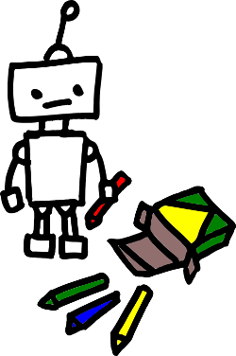
Let’s draw!
Please say the clear instructions of how to draw a face.

Slide 8

Time for group exercises!
Take a seat by one of the tables with papers on and the mentor on side :)

Slide 9
5 min break!
Get some breath :)

Slide 10
Group exercise 2: The recommender system
How do you think services like Amazon, IMDb or Spotify recommend you items, movies or music?
What data are they using?
Try to design your recommend system algorithm! :)

Slide 12
Choose your programming path Workshop Series
App Development
Game Development
Business Analytics
Front End (websites)
Back End (websites)

Slide 13

We need your feedback:
http://bit.ly/alg_think
ps. after submitting the feedback form we will share with you links to some nice articles good for starting your programming journey + you’ll get a sure place at our next workshop :)

